Slide 1
BOTCOIN Bitcoin-Mining on Botnets
Univ of California San Diego
Computer Science and Engineering
Danny Y. Huang
Hitesh Dharmdasani, Sarah Meiklejohn Vacha Dave, Chris Grier, Damon McCoy Stefan Savage, Nicholas Weaver Alex C. Snoeren, Kirill Levchenko

Slide 2
Motivation
Unique IP address → Money
Spam
→ $$$
Click-fraud
→ $$$
Computational Power → Money
Mining
Bitcoins
100% CPU
→ $$$

Slide 3
Motivation
Kevin
Loss in productivity
High electricity bill
Scale?
•
Who?
Operations?
Profitable?
Implications?
•
Bitcoin-mining
in relation to
spam/click-fraud?

Slide 4
Contributions
What we learned about botnets:
Identities
Modus Operandi
Revenue
Implications

Slide 5
How you can make bitcoins
Pick a different integer
Apply SHA-256 on integer
Mining App
Takes 100+ years
P2P Network
Found hash collision
Get 25 .

Slide 6
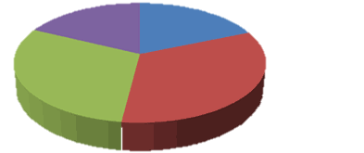
Mining Pools
Parallelizes hashing.
Finds solution faster.
Workers divide reward.
BUT:
Hardware costs
Energy costs
Mining Pool
Free!
miner.exe my_wallet http://pool.com
6

Slide 7
Botnet Mining
Mining Pool
Pool pays botnet
Malware connects to pool
We want to identify these botnets!
Victim
Victim
Victim
miner.exe botnet_wallet http://pool.com

Slide 8
Finding the Mining Malware
Malware Databases
Threat Expert, Emerging Threats, …
2,000 binaries
10 botnets
Bitcoin Malware Reports / Blogs
Leaked Data
Interviews with Pools

Slide 9
Examples of Mining Botnets
ZeroAccess
Spamming, click-fraud
Bitcoin-mining
FeodalCash
Affiliate program
Hitma UK
Fareit
BMControl
bitcoin wallet addresses in public cloud
gamers
Dload asia
xfhp.ru
Zenica
misc

Slide 10
Outline
What we learned about botnets:
Identities
Identities
2,000 binaries 10 botnets
Modus Operandi
Modus Operandi
e.g. affiliate program, wallet addresses in cloud
Revenue
Revenue
Implications

Slide 11
Botnet Mining Revenue
Lots of challenges!
Gather botnet wallet addresses
ZeroAccess
FeodalCash
486 bitcoins
in 1 year
168 bitcoins
in 3 months
Look up in public ledger (i.e. blockchain)
BMControl
3,000 bitcoins
in 1 year
Examine payments from mining pool (Meiklejohn et al)

Slide 12
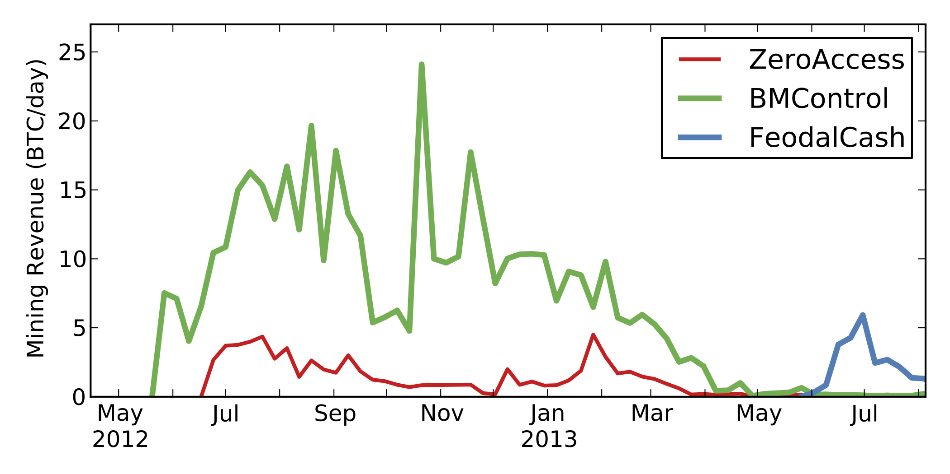
Botnet Revenue in Bitcoins

Slide 13
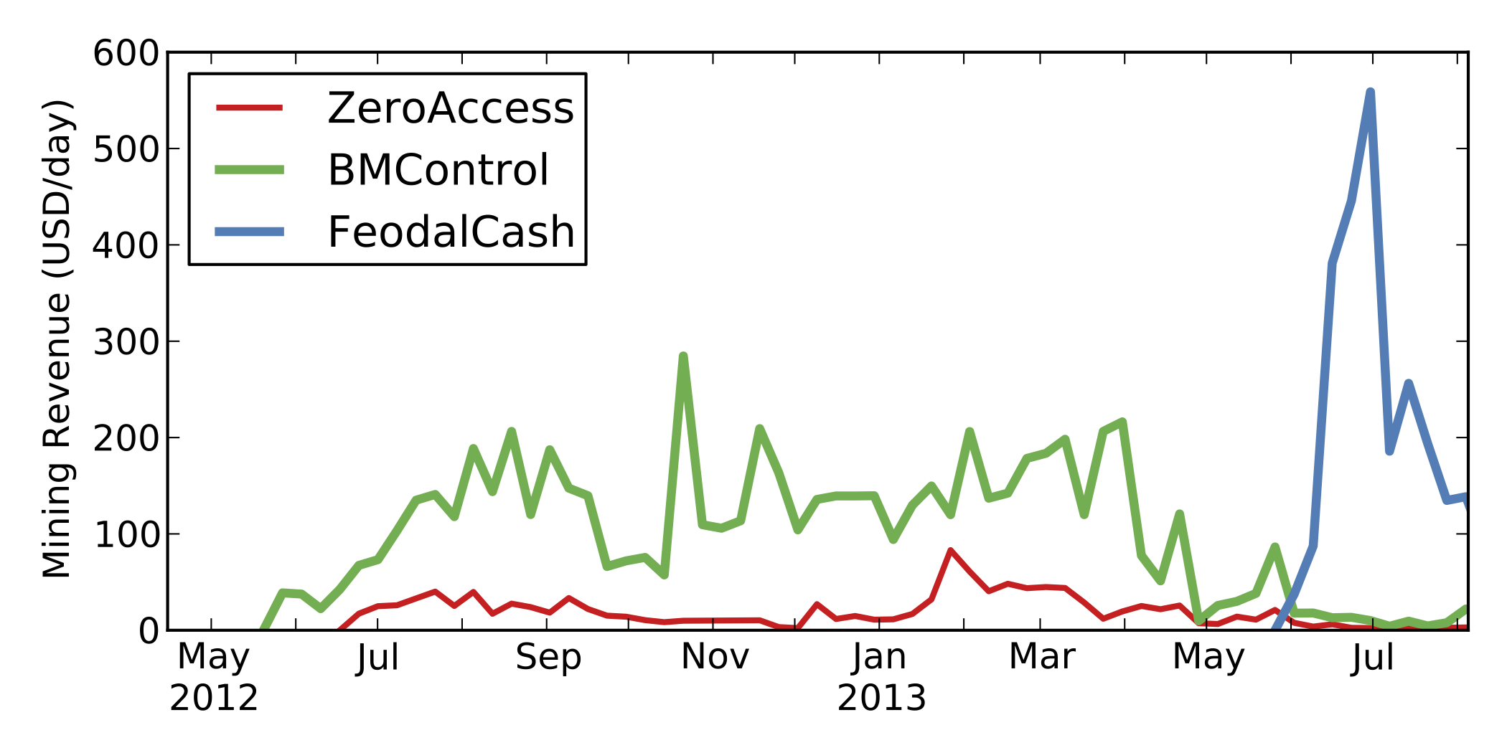
Botnet Revenue in US Dollars

Slide 14
Mining Revenue

Slide 15
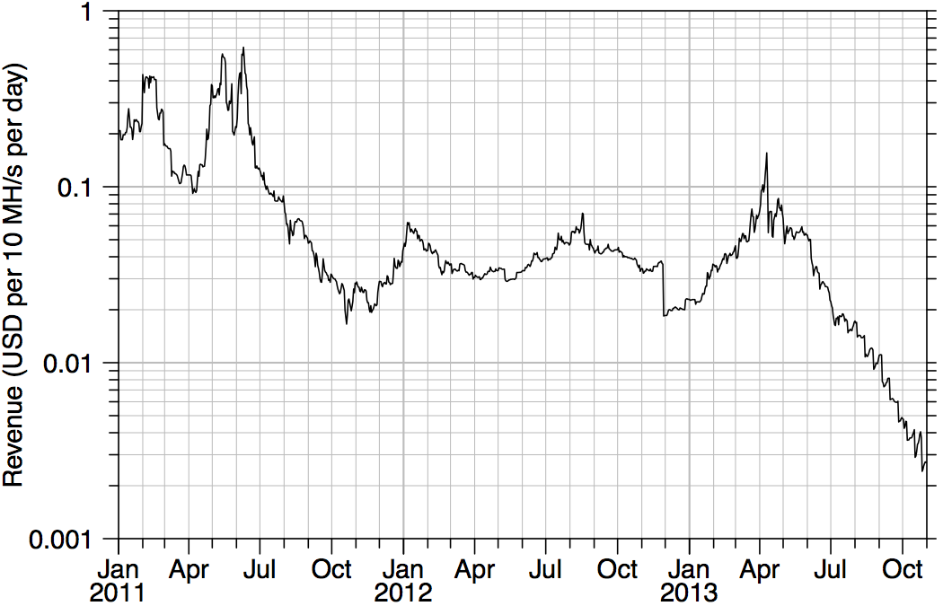
Mining Revenue
BMControl $300/day
My CPU $0.002/day
My CPU $0.20/day
BMControl $30/day

Slide 16
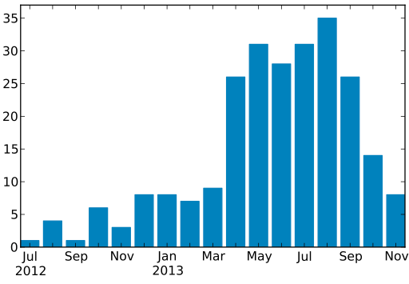
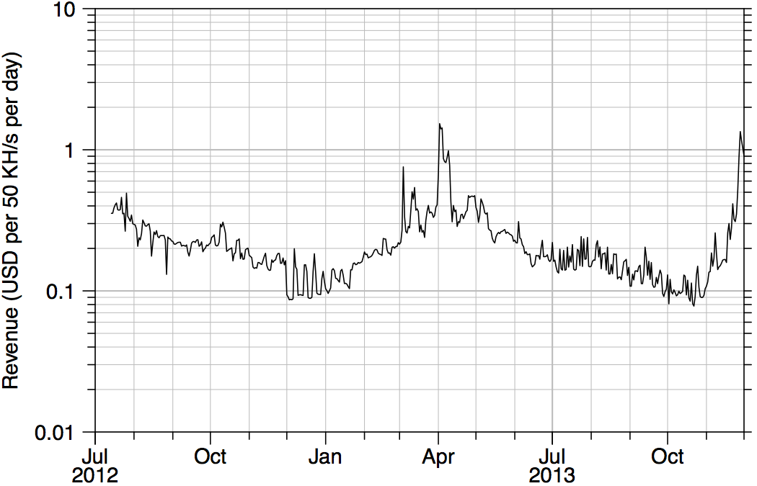
Litecoin Mining
Number of New Botnet Mining Operations
Different hash function
- Bitcoin: SHA-256
- Litecoin: Scrypt
Litecoin Mining Revenue

Slide 17
Outline
What we learned about botnets:
Identities
Identities
2,000 binaries
10 botnets
Modus Operandi
Modus Operandi
e.g. affiliate program, wallet addresses in cloud
Revenue
Revenue
4,000 bitcoins in 2 years
Implications
Implications

Slide 18
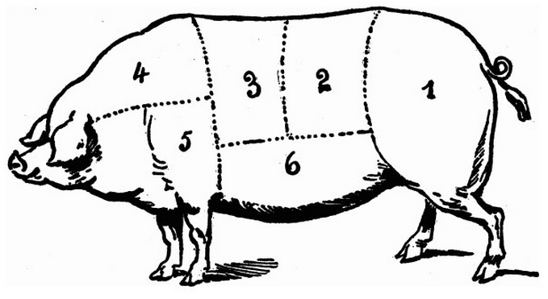
Implication & Conclusion
Spam
Bitcoin-mining
Litecoin-mining
*coin-mining
Click-fraud

Slide 20
Outline
What we learned about botnets:
Identities
Modus Operandi
Revenue
Implications

